Slide 1
The Lighthouse of Hope Fund
About the Program and Frequently Asked Questions

Slide 2
What is the Lighthouse of Hope Fund?
The Lighthouse of Hope provides funds to fulfill dreams by providing experiences for patients at the end of life. These experiences enhance the quality of life of hospice patients and their families so that their remaining time together can be meaningful and memorable.
The funds are available for patients of NHPCO member organizations. Applications can be submitted by a member of the patient’s hospice interdisciplinary team.
The fund can provide up to $1,500 for an experience.

Slide 3
What qualifies for this fund?
The fund is strictly for experiences. This could range from flying to visit a family member, to visiting the ocean, to going out to a nice dinner with loved ones.
The fund does not cover basic or medical needs.
We know those basic needs are important; however, paying for these needs is not the purpose of the Lighthouse of Hope. For those needs, try reaching out to the Dream Foundation or a local United Way or service charity.
There also must be a financial need, demonstrating that the patient could not afford this experience without assistance from Lighthouse of Hope.

Slide 4
How do I submit an application for my patient?
Visit our website: http://www.nationalhospicefoundation.org/lighthouseofhopefund
Click on “Online Request Form” and fill out the information about yourself, your patient, and the desired experience. Please include an itemized estimate of the costs.
You as the provider are point of contact with Lighthouse of Hope, not the patient or the family. NHF staff will respond to your request within 2-3 business days. If approved, we will send a check made out to the hospice.

Slide 5
What do I do after the experience?
Keep all receipts and send copies back to us. Please also include a one-page Impact Report of the activity or event, including a breakdown of how the funds were used. We need this report within 30 days after the experience.
We encourage participants to take photos and share them with us! We love seeing how the Lighthouse of Hope Fund is helping give people more memories. Please ask your patient and their family if we can share their story and have them sign the release forms.

Slide 6
Example Fund Recipient: Alex
10-year-old Alex was diagnosed with hepatopulmonary syndrome and cirrhosis of the liver, needing continuous oxygen to breathe.
When his hospice care team asked what was important in his life, he mentioned his love of swimming and going to water parks.
The Lighthouse of Hope Fund provided the money for Alex and his family to travel to a water park. Arrangements were made so Alex could enjoy swimming and just be a kid.

Slide 7
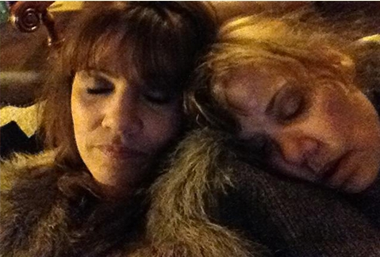
Example Fund Recipient: Dana
43-year-old Dana was diagnosed with esophageal cancer and was receiving hospice care.
One of her favorite memories was going to the beach with her twin sister, Deanna. Her final dream was to go to the beach and feel the sand and sun one last time.
The Lighthouse of Hope Fund provided the money for Dana and her Deanna to drive to the ocean and have a last memory together. Dana passed away peacefully in her sister’s arms on the way home.

Slide 8
Frequently Asked Questions
Q: What reporting does NHF require from me?
A: After the experience, we need copies of all receipts and a one-page Impact Report about the experience. These can be emailed to your point of contact at NHF. If possible, please include a photograph of the event or activity and include a family impact statement. If the report is not received from the provider in a timely manner (30 days following the experience) future grant submissions will be returned without review.
Q: What do I do if the patient dies before the experience happens?
A: If for any reason the experience is not able to occur, the funds must be returned to the National Hospice Foundation.

Slide 9
Frequently Asked Questions
Q: Can NHF issue Lighthouse of Hope checks directly to the patient or to a vendor?
A: No, checks can only be made out to the provider in the amount specified on the application. We encourage you to work with your accounting department to pay for things directly or provide the funding to the family.
Q: What if we can’t get receipts for certain things?
A: Ask for receipts whenever possible. Small amounts are acceptable without receipts but should be noted in the Impact Report. Every dollar must be reported on or returned to NHF.

Slide 10
Frequently Asked Questions
Q: My patient wants to attend an event in the next few days. Can the check be expedited?
A: Unfortunately, we cannot expedite checks. In these situations, we encourage you to talk to your accounting department and ask them to cover the up-front costs until the Lighthouse of Hope check arrives.
Q: My patient has previously received a grant from another wish-granting organization. Can we still apply to Lighthouse of Hope?
A: Patients who have received an experience from another wish-granting organization are not eligible for a grant from the Lighthouse of Hope Fund.

Slide 11
Frequently Asked Questions
Q: Can I use a Lighthouse of Hope Fund grant to pay for medical expenses or equipment?
A: No, funds are only to be used for experiences. Grants cannot be used for things like medical-related expenses, home improvements, quality of life items, funeral arrangements, basic needs, and other similar requests. Please see https://www.nationalhospicefoundation.org/program/lighthouse-hope-fund for a more detailed list of restrictions.
If you have questions about a specific patient’s request, please contact us before applying. We are happy to discuss it with you.

Slide 12
Contact Info
Other questions or concerns? Feel free to reach out:
info@nationalhospicefoundation.org
877-470-6472 or 703-516-4928

